Slide 1
Hybrid Quality-Aware and Speaker-Consistent Speech Separation for Real-World Mixed Audio
Department of Electronics and Communication Engineering | KL University, Hyderabad | Academic Year 2025–26
TEAM MEMBERS (REGISTRATION NO.)
PROJECT GUIDE
Boppana Dhatri Chowdary — 2520040012
Thunga Sree Chandana — 2520040030
Naralasetty Hasini — 2520040039
Dr. V. Sahiti
Assistant Professor
Department of ECE

Slide 2
Problem, Motivation & Practical Relevance
THE PROBLEM
WHY IT MATTERS IN PRACTICE
Overlapping speech
When two people talk together their voices add into one signal, y(t) = s₁(t) + s₂(t), and each voice is hard to recover.
Meetings and teleconferencing
Cleaner speech for each participant and for transcription.
Separation is imperfect
Neural separators can leave leakage from the other speaker, distort the voice, or mix up which output is which speaker.
Hearing aids and voice assistants
Follow one voice in a noisy room or in a car.
Outputs are trusted blindly
A separated stream is normally used without checking whether it is reliable.
Speech recognition and forensics
Wrong or distorted separated audio leads to wrong transcripts, so outputs should be checked.

Slide 3
Project Objectives
WHAT WE SET OUT TO DO
HOW WE MEASURE SUCCESS
1. Separate overlapping speakers
Use a pretrained Conv-TasNet to split a two-speaker mixture.
Separation gain
SI-SNR and SDR improvement over the unprocessed mixture.
2. Check speaker consistency
Compare each output with a speaker prototype using ECAPA-TDNN embeddings.
Decision behaviour
ACCEPT / REJECT counts and agreement with an oracle label.
3. Check separation quality
Use a re-separation, SI-SNR based quality score.
4. Decide ACCEPT or REJECT
Combine both scores into one confidence value with a threshold.
Reproducibility
A GPU notebook that runs end to end on public data.
5. Provide a fallback
If rejected, return the lightly cleaned original mixture.

Slide 4
Literature Review & Problem Investigated
EXISTING APPROACHES
THE SPECIFIC PROBLEM WE INVESTIGATE
Conv-TasNet (Luo & Mesgarani, 2019)
Time-domain separation that beats STFT masking, but gives no measure of output quality or speaker identity.
The gap
Quality checking and speaker tracking are treated separately, and separator outputs are accepted unconditionally.
Paper 1: QDM-SSD (Niu et al., 2023)
Scores segment quality by re-separation and relative SI-SNR; 18.56% lower diarization error than ISSD. No speaker identity tracking.
Our question
Can a quality score and a speaker-consistency score be combined to decide whether a separated stream is trustworthy?
Paper 2: Speaker-Discriminative Attractors (Kim et al., 2026)
Keeps speaker order consistent across streaming chunks with a memory queue of speaker prototypes. No check of output reliability.
Our approach
A hybrid pipeline inspired by both papers: confidence C = 0.5·S_spk + 0.5·S_qual with a 0.60 threshold. It adapts their ideas and is not a full reproduction.

Slide 5
Methodology: System Block Diagram
Mixed audio
y(t) = s₁(t) + s₂(t)
Pre-processing
mono, 8 kHz, align, normalize
Conv-TasNet separator
outputs two streams ŝ₁, ŝ₂
Speaker score S_spk
ECAPA-TDNN + cosine similarity
Quality score S_qual
re-separation SI-SNR + sigmoid
Output
ACCEPT: separated stream
REJECT: cleaned original mixture
Decision
C ≥ 0.60 ?
Confidence
C = 0.5·S_spk + 0.5·S_qual
Both models are pretrained and used for inference only; no training is done in this project.

Slide 6
Methodology: Signal Processing Techniques
Technique | What it does
Resampling and normalization | Convert to mono, 8 kHz, peak-normalize, then add the sources to form the mixture.
Conv-TasNet separation | Learned encoder, temporal convolution separator and decoder work directly on the waveform.
SI-SNR | 10·log₁₀(‖s_target‖² / ‖e_noise‖²), a scale-invariant fidelity measure in dB.
SDR (mir_eval) | BSS-Eval signal-to-distortion ratio, also used to match outputs to speakers.
Speaker consistency S_spk | 192-D ECAPA-TDNN embedding, L2-normalized; S_spk = (cosine + 1) / 2.
Quality score S_qual | Re-separate the stream; f = max relative SI-SNR; sigmoid with τ₁ = 10, τ₂ = 30, β = 0.3, floor 0.1.
Confidence and decision | C = 0.5·S_spk + 0.5·S_qual; ACCEPT if C ≥ 0.60, otherwise REJECT.

Slide 7
Methodology: Data Sources & Tools
DATA SOURCES
TOOLS AND MODELS
Demo clips
Two LibriSpeech utterances (1.flac, 2.flac), about 3.27 s, mixed to form one overlapping recording.
Conv-TasNet
Asteroid, pretrained JorisCos/ConvTasNet_Libri2Mix_sepclean_8k.
ECAPA-TDNN
SpeechBrain, pretrained spkrec-ecapa-voxceleb (192-D embeddings).
Evaluation data: MiniLibriMix
200 validation mixtures found; 50 chosen at random (seed 42); 40 unique speaker IDs.
Libraries
PyTorch, SoundFile, Librosa, scikit-learn, mir_eval.
Evaluation records
50 mixtures × 2 streams = 100 speaker-stream records.
Platform
Kaggle notebook, NVIDIA Tesla T4 GPU.

Slide 8
Implementation: Key Processing Stages
1. Prepare audio
2. Load models
3. Score outputs
4. Decide
5. Evaluate
Download clips, convert to mono, resample to 8 kHz, align, normalize and mix.
Load pretrained Conv-TasNet and ECAPA-TDNN onto the GPU.
Compute SI-SNR, SDR, speaker score and quality score; extract 6 features.
Confidence C, threshold 0.60, then ACCEPT or the fallback output.
Run 50 MiniLibriMix mixtures, save a CSV, plot the results.
Six features are extracted per stream (S_spk, S_qual, SI-SNR, spectral centroid, ZCR, RMS), but only S_spk and S_qual enter the decision formula.

Slide 9
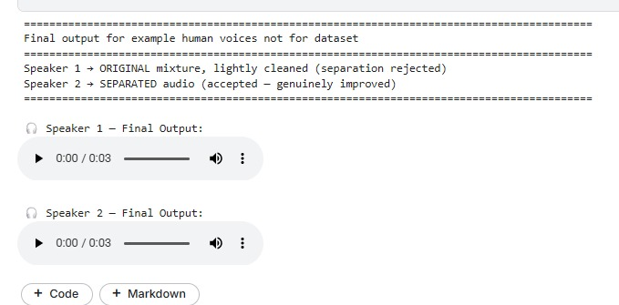
Implementation: Working System Demo
Input: 2-speaker mixture | SI-SNR in → out | SDR in → out | Confidence | Decision
Speaker 1 (male) | 1.07 → 8.20 dB | 1.23 → 8.38 dB | 46.7% | REJECT
Speaker 2 (female) | −0.90 → 6.59 dB | −0.52 → 8.51 dB | 76.8% | ACCEPT
Input
Two LibriSpeech clips (about 3.27 s) mixed into one signal.
Output
Two estimated streams, each scored and given a decision.
Result
Speaker 2 accepted; Speaker 1 rejected and replaced by the cleaned mixture.
Notebook output: final decision per speaker

Slide 10
Results: Gain over the Unprocessed Mixture
SI-SNR gain
+7.13 dB (Speaker 1) and +7.49 dB (Speaker 2).
SDR gain
+7.15 dB and +9.03 dB.
Baseline comparison
The unprocessed mixture is the baseline; separation improves both speakers.

Slide 11
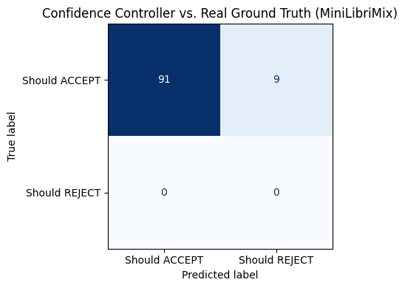
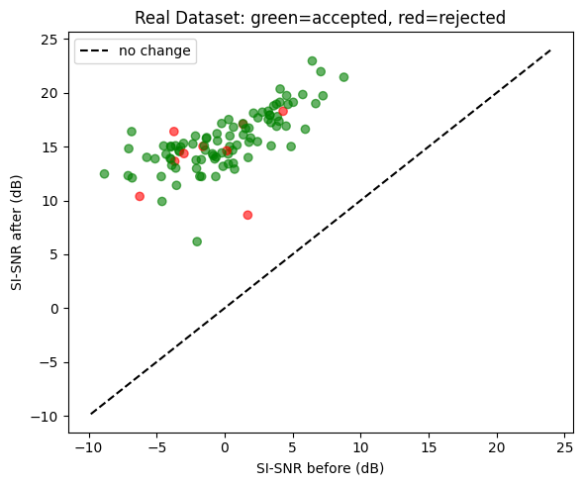
Results: MiniLibriMix (100 Streams)
91 / 9
91.0%
0.9529
+15.51 dB
ACCEPT / REJECT decisions
agreement with oracle label
decision F1-score
mean SI-SNR gain, accepted
Every segment improves
All points lie above the no-change line.
Accepted vs rejected
Mean gain +15.51 dB vs +15.45 dB.
Figure 1: Confusion matrix (oracle vs decision)
Figure 2: SI-SNR before vs after

Slide 12
Evaluation: Comparison with the Baseline
Measure | Baseline: unprocessed mixture | Proposed: separated + checked
Demo SI-SNR (Spk 1 / Spk 2) | 1.07 / −0.90 dB | 8.20 / 6.59 dB
Demo SDR (Spk 1 / Spk 2) | 1.23 / −0.52 dB | 8.38 / 8.51 dB
Mean SI-SNR gain, 100 streams | 0 dB (reference) | about +15.5 dB
Streams accepted | no checking | 91 of 100 (9 rejected)
What is proven
Separation clearly improves quality over the mixture, and the full pipeline (scoring, decision, fallback) runs end to end.
What is not yet proven
All 100 oracle labels are “should accept”, so the 91% agreement equals the accept rate and rejection of poor outputs has not been tested.

Slide 13
Conclusions: Findings, Objectives & Limitations
Objective | Outcome | Status
1. Separate speakers | About +15.5 dB mean SI-SNR gain on 100 streams | Achieved
2. Speaker consistency | ECAPA-TDNN cosine score implemented | Achieved
3. Quality score | Re-separation SI-SNR sigmoid score implemented | Achieved
4. Accept / reject | Rule-based, threshold 0.60; 91 accepted, 9 rejected | Implemented, not yet validated
5. Fallback | Lightly cleaned original mixture is returned | Achieved
LIMITATIONS
FUTURE IMPROVEMENTS
Rejection untested: no poor-quality examples.
Decision is a fixed formula, not learned.
Only 50 clean mixtures; two speakers, 8 kHz.
Test with corrupted and speaker-swapped mixtures.
Tune the threshold or train a classifier; add an ablation.
Try noisy, reverberant data and 3+ speakers.

Slide 14
References
1. Luo & Mesgarani (2019)
Conv-TasNet: Surpassing Ideal Time–Frequency Magnitude Masking for Speech Separation. IEEE/ACM TASLP, 27(8), 1256–1266.
5. Panayotov et al. (2015)
LibriSpeech: An ASR Corpus Based on Public Domain Audio Books. IEEE ICASSP, 5206–5210.
2. Niu, Du, Sun, Hu & Lee (2023)
QDM-SSD: Quality-Aware Dynamic Masking for Separation-Based Speaker Diarization. IEEE/ACM TASLP, 31, 1037–1049.
6. Cosentino et al. (2020)
LibriMix: An Open-Source Dataset for Generalizable Speech Separation. arXiv:2005.11262 (MiniLibriMix subset).
3. Kim, Kim & Kang (2026)
Speaker-Discriminative Attractors for Robust Continuous Speech Separation. IEEE TASLP, 34, 3916–3929.
7. Pariente et al. (2020)
Asteroid: The PyTorch-Based Audio Source Separation Toolkit for Researchers. Interspeech, 2637–2641.
4. Desplanques et al. (2020)
ECAPA-TDNN: Emphasized Channel Attention, Propagation and Aggregation in TDNN Based Speaker Verification. Interspeech, 3830–3834.
8. Ravanelli et al. (2021)
SpeechBrain: A General-Purpose Speech Toolkit. arXiv:2106.04624.

Slide 15
Thank You
Questions & Feedback Welcome
Hybrid Quality-Aware and Speaker-Consistent Speech Separation for Real-World Mixed Audio
Department of ECE • KL University, Hyderabad • Academic Year 2025–26

